Slide 1


REVENUE ESTIMATION FOR PROPERTIES
Airbnb
Group members: Piyush Kakde, Karan Karnik, Monika Madugula, Timothy Samuel
Get started
Notes:
Welcome, everyone, and thank you for joining our presentation. We are a dedicated team of four—myself, Piyush, alongside Karan, Monika, and Timothy. We have undertaken a project centered on revenue prediction for Airbnb hosts. Throughout this presentation, each of us will guide you through different segments of our project. We will culminate with a demonstration of how our predictive model can empower Airbnb hosts to improve their revenue. Stay tuned as we unfold the narrative of data-driven success in hospitality.

Slide 2

Executive Summary
In our presentation, we introduce a predictive model designed to estimate revenue for Airbnb properties in Dallas. This model leverages historical data by conducting exploratory data analysis (EDA), identifying key features, and building the model.
Our comprehensive analysis focuses on identifying factors that significantly influence revenue, such as property characteristics, socio-economic elements, and seasonal trends. Through this, we aim to empower Airbnb hosts with data-driven insights for optimized revenue decisions in the dynamic short-term rental market.
Notes:
Today, we will introduce a predictive model designed to forecast Airbnb property revenues in Dallas. By analyzing historical data and identifying key revenue drivers, our model offers hosts actionable insights to optimize their earnings in a dynamic market

Slide 3
01
Introduction
and Problem Statement

Slide 4
>7M
active listings worldwide as of June 30, 2023
Airbnb
Company Overview
220+
countries and regions with Airbnb listings as of December 31, 2022
Founded in 2007 by Joe Gebbia and Brian Chesky, Airbnb is a digital platform that facilitates the rental of private homes, rooms, and unique accommodations, connecting hosts with guests. It offers a diverse range of lodging options, including apartments, beach houses, cabins, and more
$180B
earned by Hosts, all-time
as of December 31, 2022
100K
cities and towns with active Airbnb listings as of December 31, 2022
See References
Notes:
Airbnb, established in 2007 by Joe Gebbia and Brian Chesky, revolutionized accommodation rental by linking hosts with guests through a digital platform. It boasts over 7 million active listings globally as of mid-2023, with a presence in over 220 countries and regions. By the end of 2022, Airbnb had facilitated earnings of $180 billion for hosts and maintained listings in more than 100,000 cities and towns, offering a wide array of lodging options like apartments, beach houses, and cabins.

Slide 5

Problem Statement
Developing a Revenue Estimation Model for Properties
This involves creating a predictive model that estimates potential revenue 3 months from now based on a combination of property characteristics, socio-economic factors, geographic features, and seasonality
Notes:
While the opportunity to earn through Airbnb is significant, hosts face the challenge of pricing their listings competitively while maximizing revenue. Our aim with this model is to project potential earnings for the Quarter ahead, by analyzing a mix of critical factors. These include the unique attributes of each property, the socio economic conditions and seasonality.

Slide 6
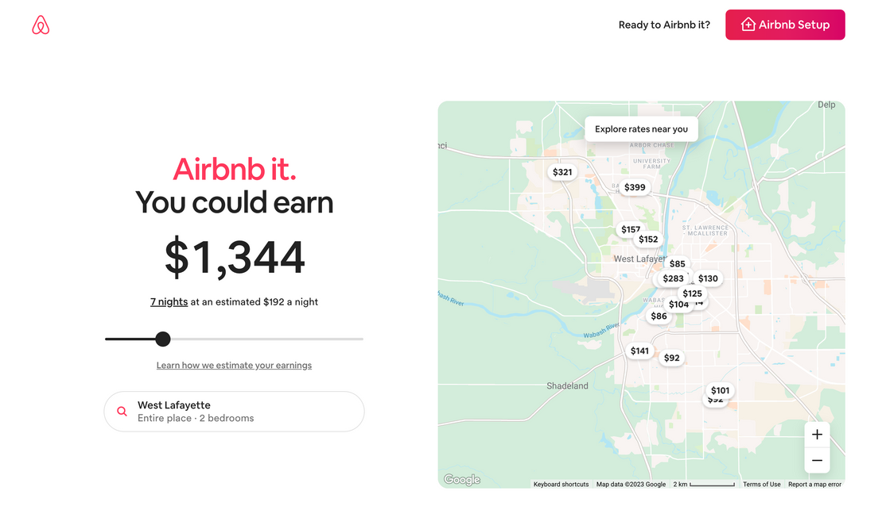



Interactive tool offered by Airbnb
What’s My Place Worth?
Number of bedrooms
While Airbnb offers a tool that assists prospective hosts in understanding potential earnings from sharing their space (nightly rate), it only takes into account factors such as location, type of listing, and number of bedrooms
Location
Type of listing
See References
Notes:
Airbnb's "What’s My Place Worth?" tool provides prospective hosts with an estimate of potential earnings from their listings. This interactive tool considers factors like location, listing type, and the number of bedrooms to suggest a nightly rate. However, it doesn't account for a broader range of variables that can influence revenue, such as socio-economic factors, detailed property characteristics, or seasonal trends, which are crucial for a more comprehensive revenue prediction.

Slide 7



Examining from the perspective of key stakeholders
Why is this problem important?
Hosts
Hosts are interested in predicting the potential revenue they can earn from their property listings
Guests
Airbnb
As demand for short-term rentals will continue to show strong growth in 2023 with a 5.5% increase in booked stays, guests will benefit from new listings and price variety
As per the Q3 2023 shareholder letter, Airbnb's strategic priorities include, "Making hosting mainstream” and ‘Perfecting core services"
See References
Notes:
-Perfecting core features: Add more features in the app
-Making hosting mainstream: Making hosting as common as travelling
-When more hosts will include listings guests will have more options to choose from thereby improving customer experience
Airbnb's strategic objectives, as outlined in their Q3 2023 shareholder letter, include mainstreaming hosting as common as travelling and enhancing core services. In pursuit of this, Airbnb is planning to launch over 350 features, focusing on customer service, transparent pricing, and tools for competitive host pricing. This aligns with hosts' interests in accurately forecasting potential revenue from their listings. The ability to predict earnings is crucial for hosts to make informed decisions about their properties. This shift not only benefits hosts financially but also enriches guest experiences by offering a wider array of choices. In essence, more hosts mean more diverse options, leading to a better, more personalized experience for guests.

Slide 8
02
Data Investigation

Slide 9


Dataset
Airbnb: Dallas
Each row represents an Airbnb listing's data for a specific Superhost evaluation period, capturing both current and historical performance metrics
Superhost Evaluation Periods and Corresponding Data Time Frames
superhost_period_all
Evaluation months
Time period of data checked
Number of rows: 48,711
Number of columns: 95 (few columns are duplicated)
Missing values in the 'revenue' column: 16,861
Evaluation periods (superhost_period_all): 5 to 20
Property IDs that do not have information across all evaluation periods: 9,348
prev_xyz variables: Capture information about previous evaluation period
xyz_year variables: Capture information about previous year
Jul 1st - Sept 30th, 2016
Jul 1st 2015 - Jun 30th, 2016
5
Oct 1st - Dec 31st, 2016
Oct 1st 2015 - Sep 30th, 2016
6
7
Jan 1st - Mar 31st, 2017
Jan 1st - Dec 31st, 2016
Notes:
Overview of Dataset: "Our dataset is expansive, encompassing 48,711 rows. Each row is a unique narrative, representing an Airbnb listing's journey through different Superhost evaluation periods. With 95 columns in this dataset, we have a wealth of information, though some columns contain duplicated data, reflecting different facets of the same story."
Key Features of the Dataset: "In this dataset, see current and historical performance metrics. However, a point to note - there's a significant absence of data in the 'revenue' column, with 16,861 missing values.
Superhost Evaluation Periods: "The Superhost evaluation periods, ranging from 5 to 20, are pivotal. They offer us a time-lapse view of each listing's performance, allowing us to track and analyze a listing’s journey.”
Each evaluation period is 3 months long basically representing a quarter in a year. For example, superhost period 5 is from July 1st to September 30th and the time period of data checked is July 1st 2016 to June 30th 2015
Inconsistencies in Data: "A critical observation here - 9,348 property IDs lack consistent data across all evaluation periods. This inconsistency is a reminder of the dynamic and ever-evolving nature of Airbnb listings and the challenges in data collection."
Variable Types: Two sets of variables that provide historical data are

Slide 10

Exploratory Data Analysis
Target variable: ‘revenue’
01
Removed Irrelevant Records
02
Handled Missing values
03
Outlier Treatment
Dropped rows with missing values for ‘revenue’
Dropped variables that weren’t useful in our prediction or were duplicated
Dropped variables from the current evaluation period and retained those from the previous period. For instance, we kept 'prev_occupancy_rate' and dropped 'occupancy_rate'
Imputed missing values for numerical variables using the median value imputation method and for categorical variables using the Mode value imputaion, after grouping the variables by 'Property Type', 'Zipcode', 'Bedrooms', 'Bathrooms', and 'Max Guests'
Used the flooring and capping method for outlier treatment
Formula used to set upper and lower bounds:
lwr_bound = q1-(1.5*IQR) upr_bound = q3+(1.5*IQR)

Slide 11

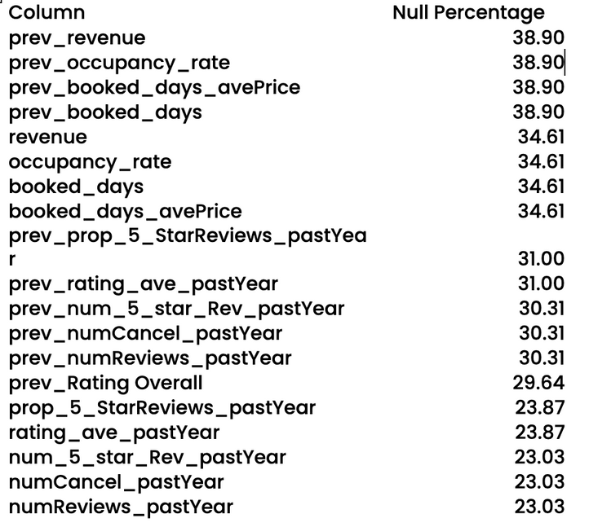

Exploratory Data Analysis
Missing values

Slide 12
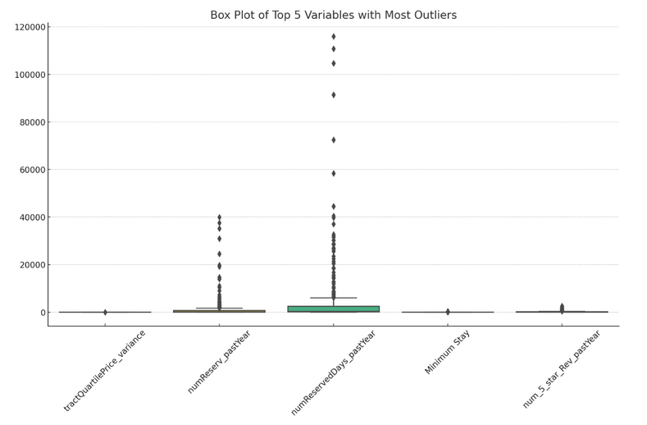
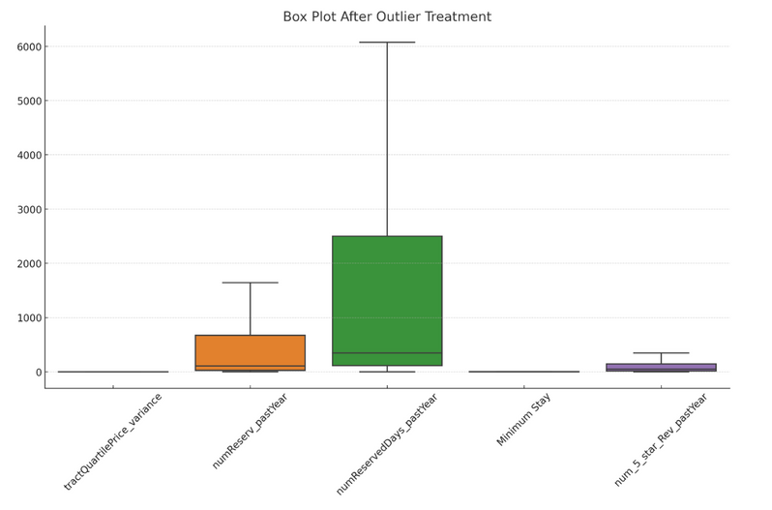
Exploratory Data Analysis
Outlier treatment
Before outlier treatment
After outlier treatment

Slide 13
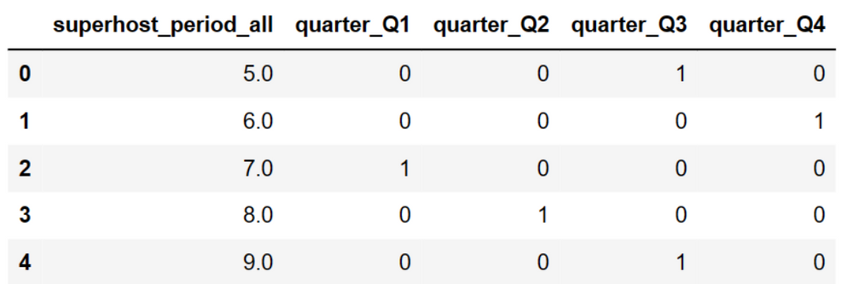
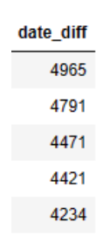
Steps in Data Transformation
Feature Creation
Added a 'quarter' column to facilitate the analysis of quarterly data
Used one-hot encoding to process categorical variables such as, 'superhost_period_all,' 'Property Type,' 'Listing Type,' ‘quarter,’ 'Neighborhood,' and 'Pets Allowed
Created a 'date_diff' column which calculates the number of days from the listing date on Airbnb to January 1st, 2023
Converted percentages to actual numbers, resulting in the creation of two new columns: 'tract_white_count' and 'tract_black_coun
One-hot encoded quarter variable
date_diff

Slide 14
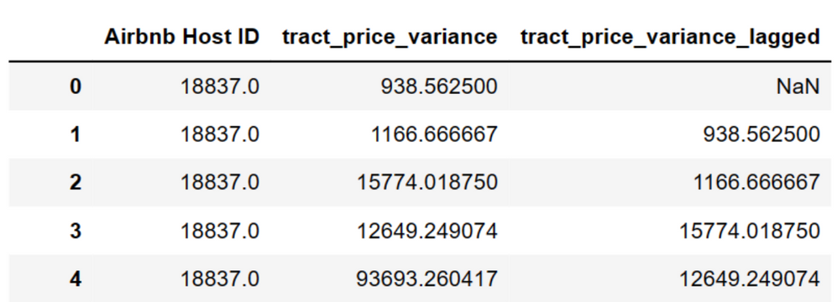

Lagged variables
Feature Creation
For certain features lacking data from the previous evaluation period, we introduced a one-period lag and dropped the original variables.
The variables for which we created lagged columns include:
'Max Guests', 'Cleaning Fee (USD)', 'Minimum Stay', 'Number of Photos', 'tract_superhosts', 'tract_superhosts_ratio', 'tract_price_variance', 'tractQuartilePrice_variance', 'booked_days_period_city', 'revenue_period_city', 'booked_days_period_tract', 'revenue_period_tract', 'tract_booking_share', 'tract_revenue_share'
Choosing not to include these variables from the same evaluation period as the revenue column in the prediction model is a strategic decision aimed at ensuring timeline consistency in the dataset
Dropped
New column

Slide 15
03
Model Implementation

Slide 16
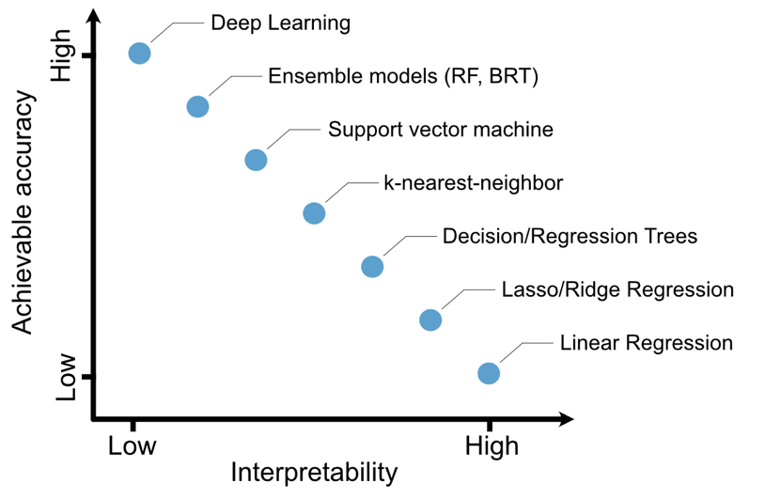


Balancing Accuracy and Interpretability in Model Development
Our Approach
1
Developed a high-accuracy model with low interpretability
2
Identified the important variables influencing the model
3
Created another model with the important variables which provides low accuracy and high interpretability
Accuracy v/s Interpretability
Notes:
In this slide, we explore our three-step approach to balancing accuracy and interpretability in model development. Initially, we developed a high-accuracy model with low interpretability to maximize predictive performance. Next, we identified the important variables influencing the model, which aided in understanding the driving factors behind revenue. We then removed the less important variables and fit it into a much simpler model. While this model has slightly lower accuracy, it provides higher interpretability.
The graph illustrates the trade off across models between accuracy and interpretability.

Slide 17
01
XG Boost
02
Optimized XG Boost
R-squared: 0.7124
Excels in predictive accuracy due to its advanced regularization which prevents overfitting, making it ideal for complex datasets with many features, as it can effectively capture intricate patterns
R-squared: 0.7201
The gridsearch optimization process fine-tunes the model parameters, increasing the R-squared value.
Model Summary
03
Variable Identification
04
Backward Linear Regression
Identifying key variables streamlines the model, this not only improves model efficiency but also aids in understanding the driving forces behind revenue trends.
R-squared: 0.6718
Provided a simpler, yet effective model that can be particularly useful for stakeholders who require a straightforward model that is easy to interpret and communicate
Notes:
Our first model is XG Boost, which is a powerful machine learning algorithm from the family of gradient boosting methods. It's designed to be highly efficient, and scalable. The model therefore resulted in an R-squared of 0.7124, indicating strong predictive capabilities. The strength of XG Boost lies in its ability to manage a large number of features and its advanced regularization, which helps in reducing overfitting. Thus it is ideal for handling complex datasets, such as ours.
Building on the XG Boost, we applied grid search optimization to fine-tune the hyperparameters, resulting in an improved R-squared of 0.7201. The optimization process involved systematically working through multiple combinations of parameter tunes, cross-validating it, and determining which tune gives the best performance.
Subsequently we Identified and utilized the key variables allowing us to streamline the model and improve efficiency. This step provided us with clear insights into which variables most significantly drive the revenue trends we are predicting.
Lastly, we have the Backward Linear Regression model, where we used only the significant variables identified in the previous step. It gave us an R-squared of 0.6718. This model takes a more traditional approach, which, while simpler and less accurate than the boosted models, offers high interpretability. It's especially useful for stakeholders who prefer straightforward, easily understandable models. This model's approach begins with all candidate variables and systematically removes the least significant ones, thus focusing on the variables with the most predictive power.

Slide 18
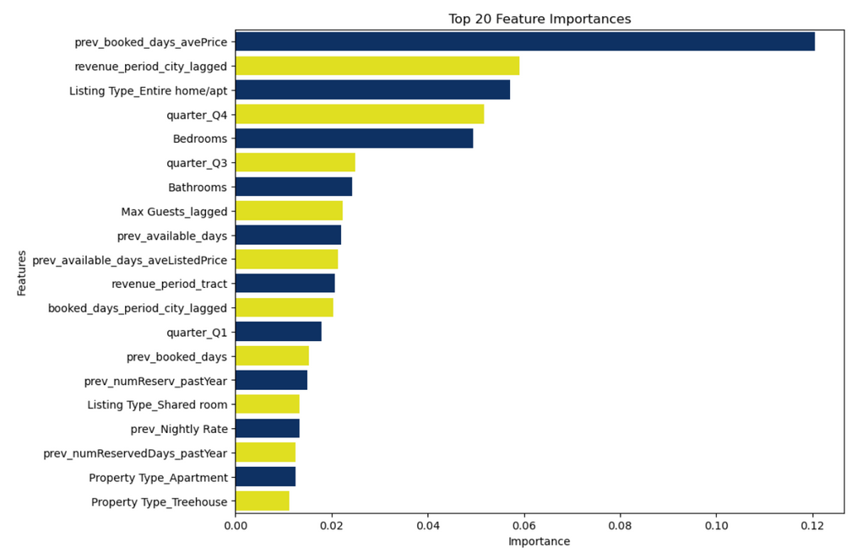
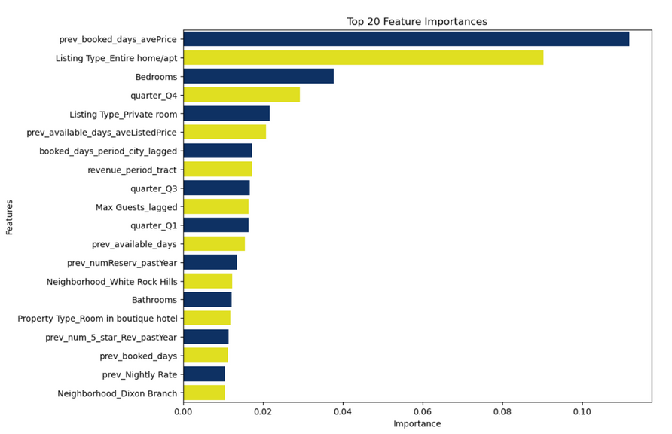
Model Summary: XG Boost
XG Boost
Optimised XG Boost
Gridsearch results
Variable importance
Variable importance
Notes:
Here we have included graphs depicting the variable importance from each of the XG Boost models. The important features include the average price from the previous evaluation period, listing type, number of bedrooms, bathrooms, etc. The screenshot on the top right illustrates the best parameters after grid search.
In the optimized XG Boost, the top 20 variables have only changed slightly, indicating a stable feature significance across models. This stability suggests that the identified variables hold consistent predictive power, reinforcing the robustness of our modeling approach.

Slide 19
Model Summary: Backward Regression
Calculator for revenue estimation
Predicted Revenue = -801.6 + (270.6 X Bathrooms) + (113.0 X Bedrooms) + (385.0 X Listing_Type_Entire_home_apt) - (482.4 X Listing_Type_Shared_room) + (140.3 X Max_Guests_lagged) + (3315.1 X Property_Type_Treehouse) - (0.0350 X booked_days_period_city_lagged) + (1.9543 X prev_Nightly_Rate) + (7.8075 X prev_available_days) - (3.1037 X prev_available_days_aveListedPri) + (17.2615 X prev_booked_days) + (13.7430 X prev_booked_days_avePrice) + (0.5187 X prev_numReserv_pastYear) - (0.0729 X prev_numReservedDays_pastYear) + (228.6 X quarter_Q3) - (464.5 X quarter_Q4) + (0.000197 X revenue_period_city_lagged) + (0.000339 X revenue_period_tract)
Illustration:
Increasing the number of bedrooms by 1 results in a $113 rise in total revenue, all else being equal
Adding 1 bathroom leads to a $270 increase in total revenue, with all other factors constant
Property characteristics
Socio-economic factors
Seasonality
Notes:
The provided equation is the result of a backward linear regression process which has refined the model down to 18 key variables such as number of bedrooms, bathrooms, listing type etc. These variables fall into three distinct categories: property characteristics, socio-economic factors, and seasonality. The slide's illustration serves to demonstrate the practical implications of the model. For instance, increasing the number of bedrooms by 1 results in a $113 rise in total revenue, all else being equal.

Slide 20
04
Business Application

Slide 21
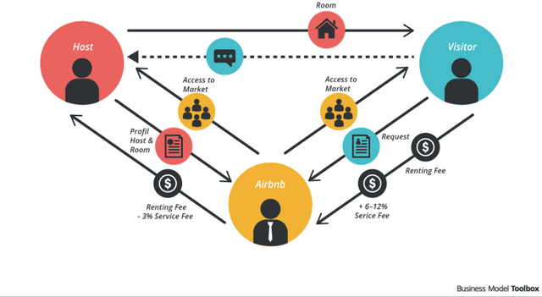
Network Effects

Slide 22

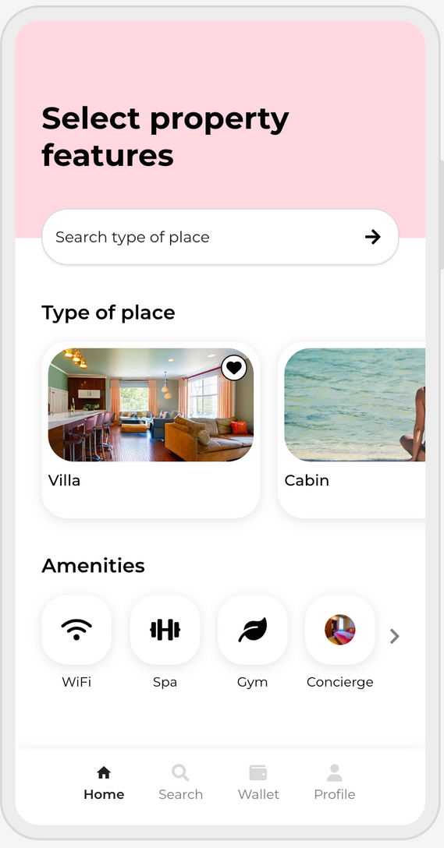
New interactive tool
App Mockup
We aim to reimagine the existing interactive tool 'What's My Place Worth' to provide hosts or potential hosts with a more accurate estimate of their revenue, based on a broader range of features

Slide 23

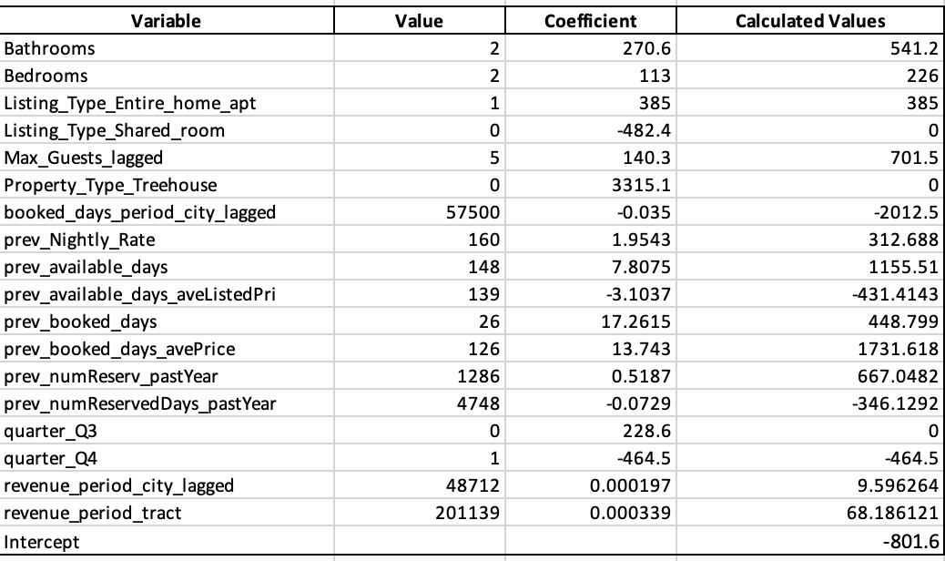
Product Portfolio
Current Host Revenue Forecast
Dua Lipa
Airbnb host since 2016
Dua is interested in maximizing her income using data-driven insights to make informed decisions about property management, pricing strategies, and potential upgrades that could increase her property’s appeal and profitability
Predicted Revenue: $2191.002
*Values based on averages

Slide 24



Conclusion
Examining from the perspective of key stakeholders
Supply and Pricing Optimization: Airbnb's revenue estimates enable hosts to price properties effectively, aligning with market supply and demand
Market Intelligence: Making data-driven decisions in terms of platform updates, policy changes, or new feature rollouts. Airbnb can identify and promote properties with high revenue potential, thereby increasing its commission earnings.
Airbnb
Revenue Prediction: Current and future hosts can benefit by understanding the potential income from their property listings
Investment Decisions: Provides data-driven insights for hosts considering property investments or enhancements to maximize future revenue
Hosts
Improved Listings: Revenue predictions could motivate hosts to enhance property features, improving guest experience.
Availability: Confidence in revenue generation may encourage hosts to increase the number of available listings, providing guests with more options and possibly lower prices
Guests

Slide 25


Thank You

Slide 26
References and Appendix
Slide 6: (Interactive tool) https://www.airbnb.com/host/homes
Slide 7: https://news.airbnb.com/airbnb-q3-2023-financial-results/
Slide 7: https://community.withairbnb.com/t5/Ask-about-your-listing/Estimating-Revenue/m-p/1704423
Slide 7: https://www.airdna.co/industry-report/2023-us-airdna-outlook-report

Slide 27
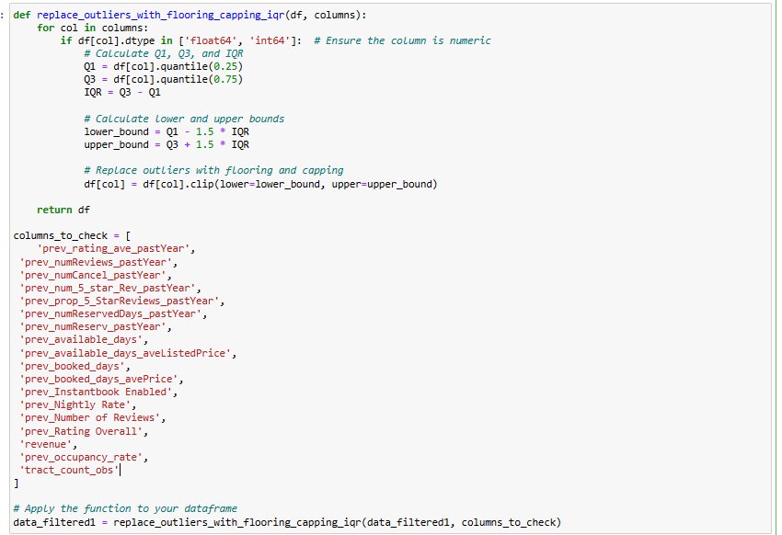
Outlier Treatment

Slide 28
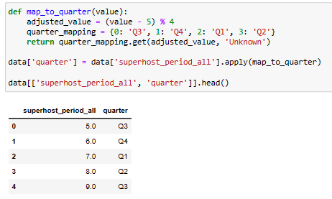
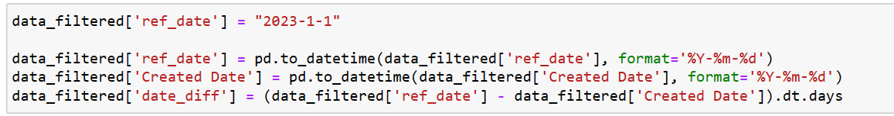
Feature Creation
ref_date
quarter

Slide 29
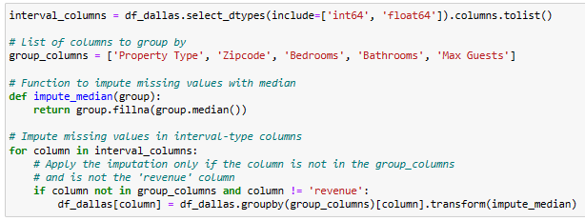
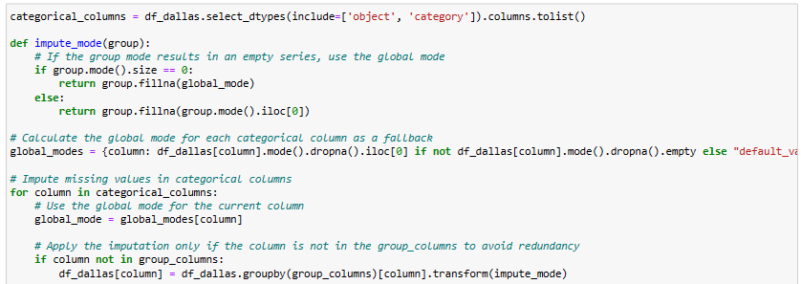
Data Imputation
Median
Mode

Slide 30
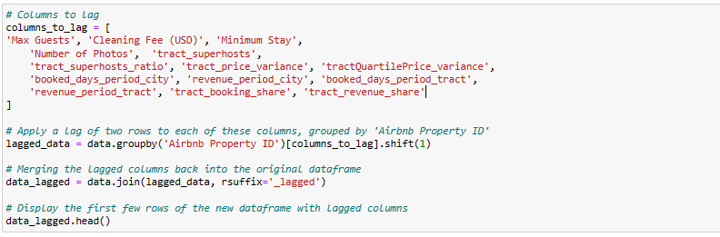
Lagged Columns

Slide 31
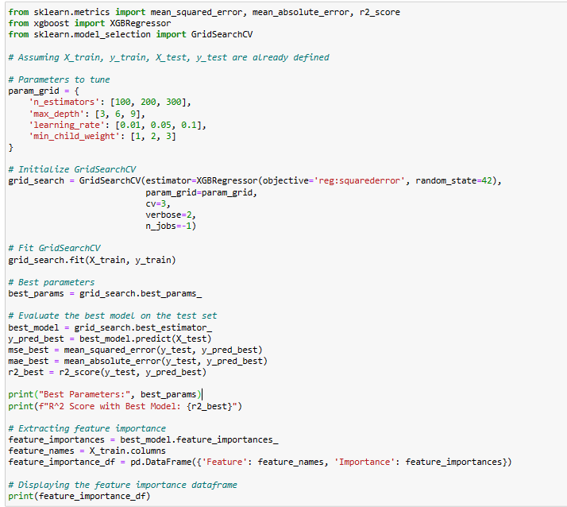
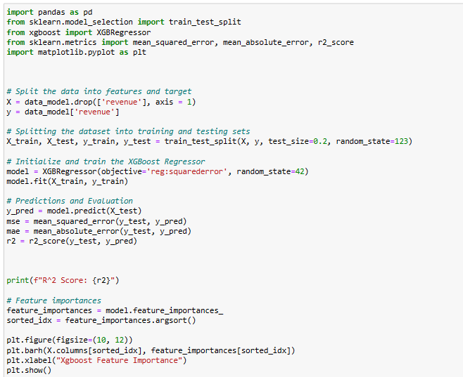
XG Boost Python Code
GXBoost
Gridsearch GXBoost

Slide 32
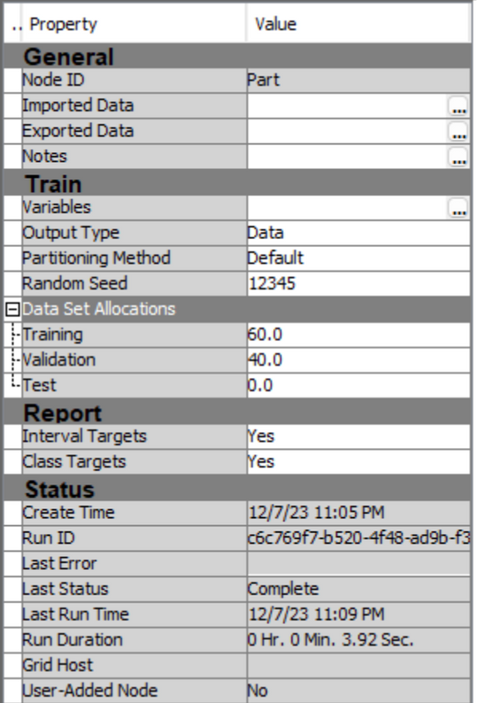
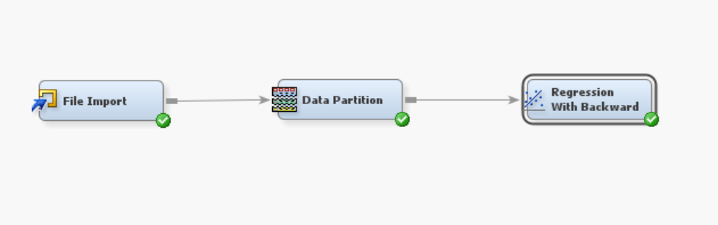
SAS EM diagram

